Slide 1


<Thanh Nguyen>
<November 21 2025>

Slide 2

Outline
Executive Summary
Introduction
Methodology
Results
Conclusion
Appendix

Slide 3
Executive Summary
In this capstone project, we aim to predict whether the SpaceX Falcon 9 first stage will successfully land by applying a variety of machine learning classification techniques.
The project involves several key stages:
Collecting, cleaning, and preparing the data
Performing exploratory data analysis
Creating interactive visualizations
Building and evaluating machine learning models
Our visualizations reveal that certain launch characteristics are correlated with the success or failure of the first-stage landing. Based on our model evaluations, the decision tree algorithm appears to be the most effective at predicting Falcon 9 landing outcomes.

Slide 4
Introduction
This capstone project focuses on building a model that can predict the likelihood of a successful Falcon 9 first-stage landing. The motivation behind this analysis comes from the significant cost advantage SpaceX holds due to its reusable rockets. While competing launch providers charge around $165 million per mission, SpaceX advertises launch prices as low as $62 million, made possible largely by recovering the first stage. If we can estimate whether the booster will land, we can also estimate the potential cost of a launch, which is useful for any organization looking to compete with SpaceX in commercial launch bids.
It is also important to recognize that some “unsuccessful” landings are not failures—SpaceX sometimes performs intentional ocean landings when booster recovery is not planned.
The goal of this project is to determine whether we can accurately predict the landing outcome using features from each launch, such as payload mass, orbit type, launch site, and mission details. Our central objective is to understand how these variables influence landing success and to develop a model capable of making reliable predictions.

Slide 5

Section 1

Slide 6
Methodology
The overall methodology includes:
Data collection, wrangling, and formatting, using:
SpaceX API
Web scraping
Exploratory data analysis (EDA), using:
Pandas and NumPy
SQL
Data visualization, using:
Matplotlib and Seaborn
Folium
Dash
Machine learning prediction, using
Logistic regression
Support vector machine (SVM)
Decision tree
K-nearest neighbors (KNN)

Slide 7
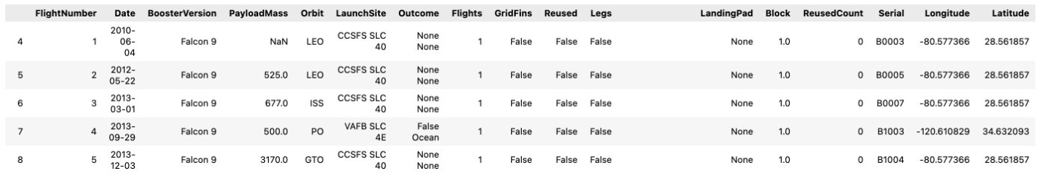
Data Collection
SpaceX API
The API used is https://api.spacexdata.com/v4/rockets/.
The API provides data about many types of rocket launches done by SpaceX, the data is therefore filtered to include only Falcon 9 launches.
Every missing value in the data is replaced the mean the column that the missing value belongs to.
We end up with 90 rows or instances and 17 columns or features. The picture below shows the first few rows of the data:

Slide 8
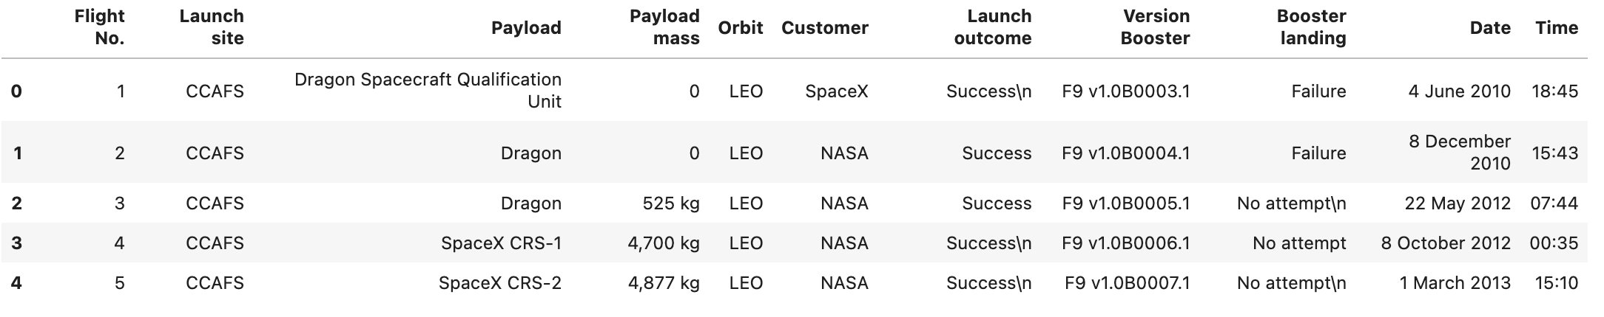
Data Collection – Web Scraping
The data is scraped from https://en.wikipedia.org/w/index.php?title=List_of_Falcon_9_and_Falcon_Heavy_launches&oldid=1027686922
The website contains only the data about Falcon 9 launches.
We end up with 121 rows or instances and 11 columns or features. The picture below shows the first few rows of the data:

Slide 9
EDA with Pandas
Pandas and NumPy
We use functions from the Pandas and NumPy libraries to explore and summarize the dataset. These tools help us generate essential insights, such as:
How many launches occurred at each launch site
The frequency of different orbit types
The count and distribution of various mission outcomes

Slide 10
EDA with SQL
SQL
SQL queries are applied to further analyze and extract information from the data. With SQL, we can answer questions like:
What launch sites appear in the mission records
The total payload mass transported by boosters on NASA (CRS) missions
The average payload mass for launches using the F9 v1.1 booster version

Slide 11
Build an Interactive Map with Matplotlib and Seaborn
We use Matplotlib and Seaborn to create visual charts—like scatterplots, bar charts, and line graphs—to help us better understand the data.
These visualizations show how different features are related, such as:
How flight number varies by launch site
How payload mass compares across different launch sites
How success rates differ by orbit type

Slide 12
Build an Interactive Map with Folium
The Folium library is used to create interactive map visualizations of the launch data. With Folium, we can:
Plot the locations of all launch sites on a map
Display markers showing successful and failed launches at each site
Map the distances from each launch site to nearby features, such as the closest city, railway, or highway

Slide 13
Build a Dashboard with Plotly Dash
Dash is used to build an interactive webpage where users can adjust inputs using a dropdown menu and a range slider.
The dashboard uses a pie chart and a scatterplot to display:
The total number of successful launches for each launch site
How payload mass is related to whether a mission succeeded or failed at each launch site

Slide 14
Machine Learning prediction
We use the Scikit-learn library to build and evaluate our machine learning models.
The prediction process involves several key steps:
Standardizing the dataset
Splitting the data into training and testing sets
Building different machine learning models, including:
Logistic Regression
Support Vector Machine (SVM)
Decision Tree
K-Nearest Neighbors (KNN)
Training each model using the training data
Tuning hyperparameters to find the best settings for each model
Evaluating model performance using accuracy scores and confusion matrices

Slide 15
Results
The results are split into 5 sections:
SQL (EDA with SQL)
Matplotlib and Seaborn (EDA with Visualization)
Folium
Dash
Predictive Analysis

Slide 16
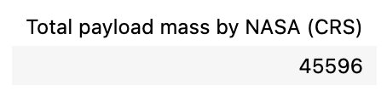
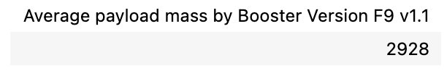
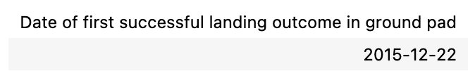
SQL (EDL with SQL)
The total payload mass carried by boosters launched by NASA (CRS)
The average payload mass carried by booster version F9 v1.1
The date when the first successful landing outcome in ground pad was achieved

Slide 17
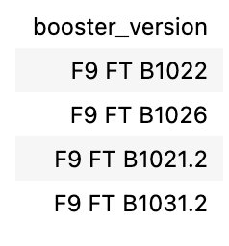
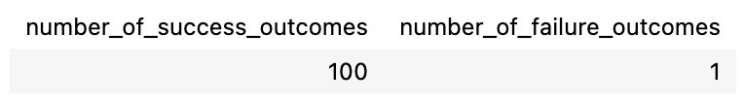
SQL (EDL with SQL)
The names of the boosters which have success in drone ship and have payload mass greater than 4000 but less than 6000
The total number of successful and failure mission outcomes

Slide 18
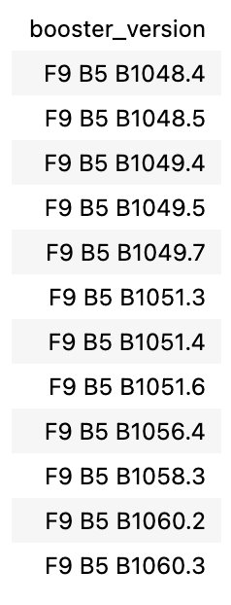
SQL (EDL with SQL)
The names of the booster versions which have carried the maximum payload mass

Slide 19
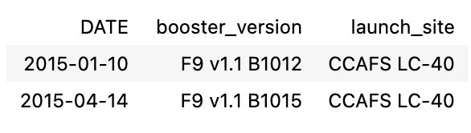
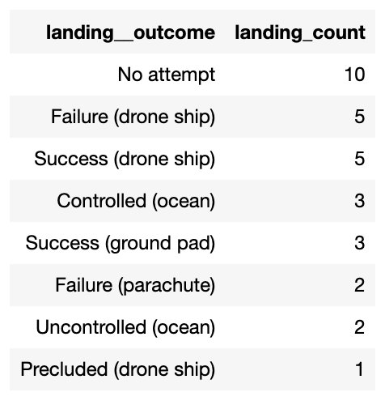
SQL (EDL with SQL)
The failed landing outcomes in drone ship, their booster versions, and launch site names for in year 2015
The count of landing outcomes between the date 2010-06-04 and 2017-03-20, in descending order

Slide 20
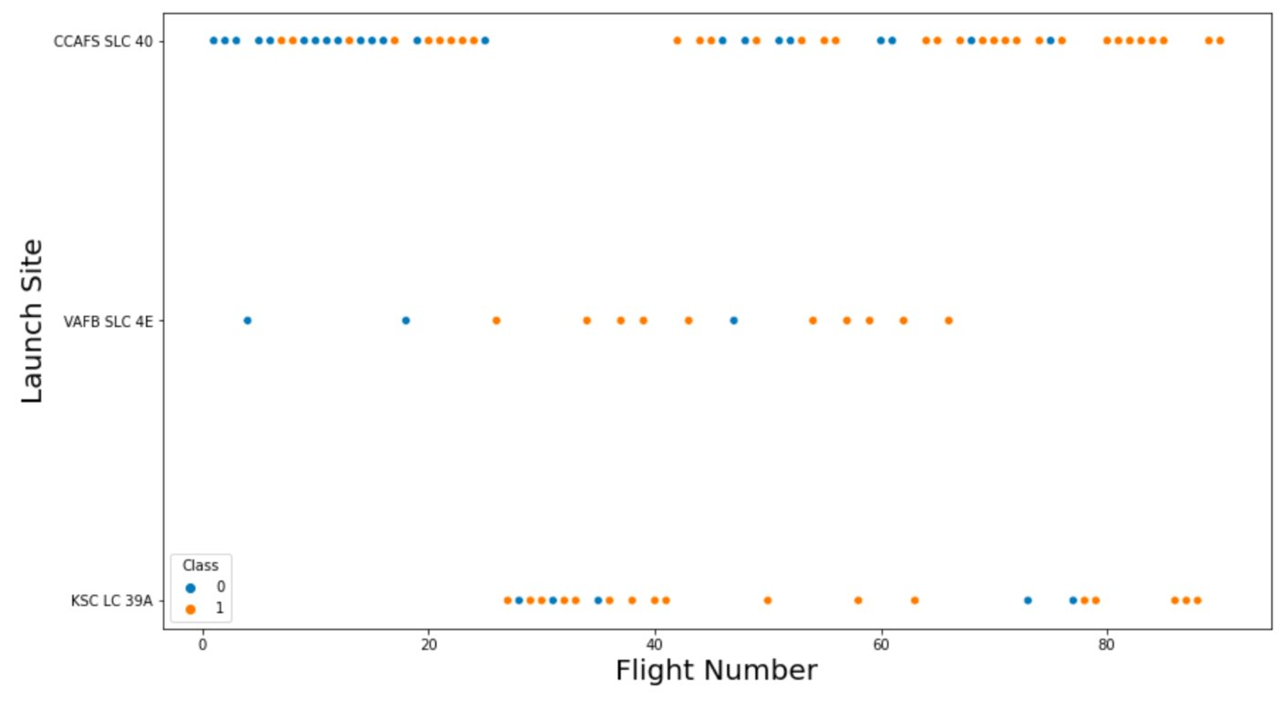
Matplotlib and Seaborn
Flight number vs launch site

Slide 21
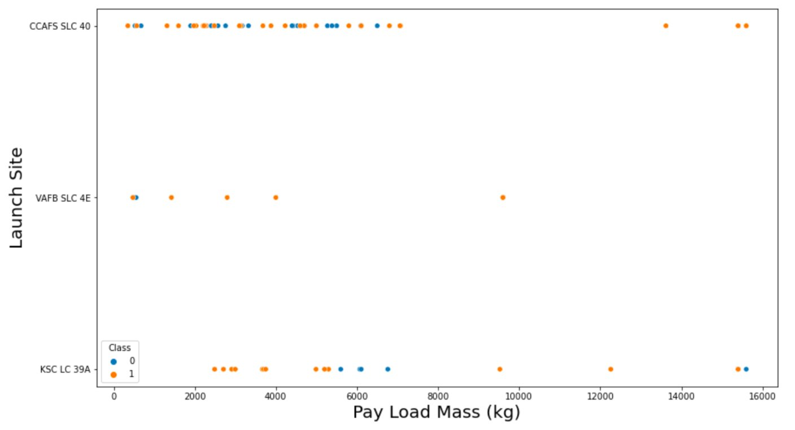
Matplotlib and Seaborn
Payload mass vs launch site

Slide 22
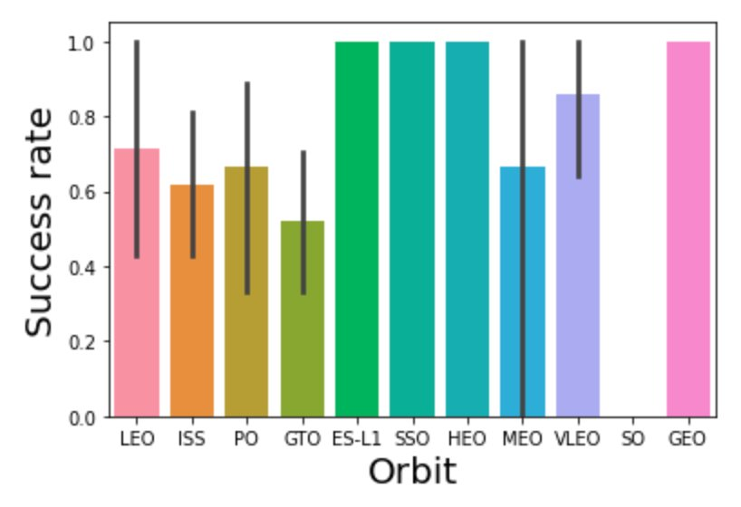
Matplotlib and Seaborn
success rate vs orbit type

Slide 23
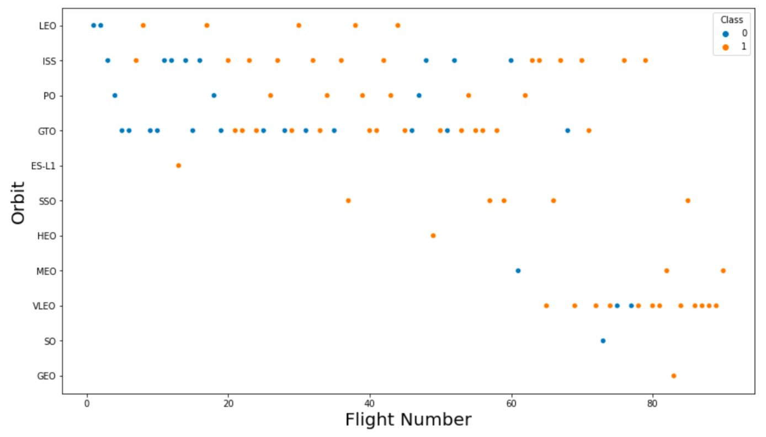
Matplotlib and Seaborn
Flight number vs orbit type

Slide 24
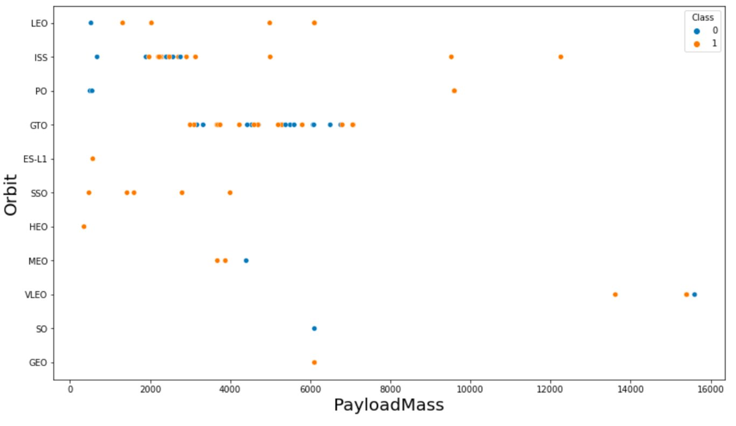
Matplotlib and Seaborn
payload mass vs orbit type

Slide 25
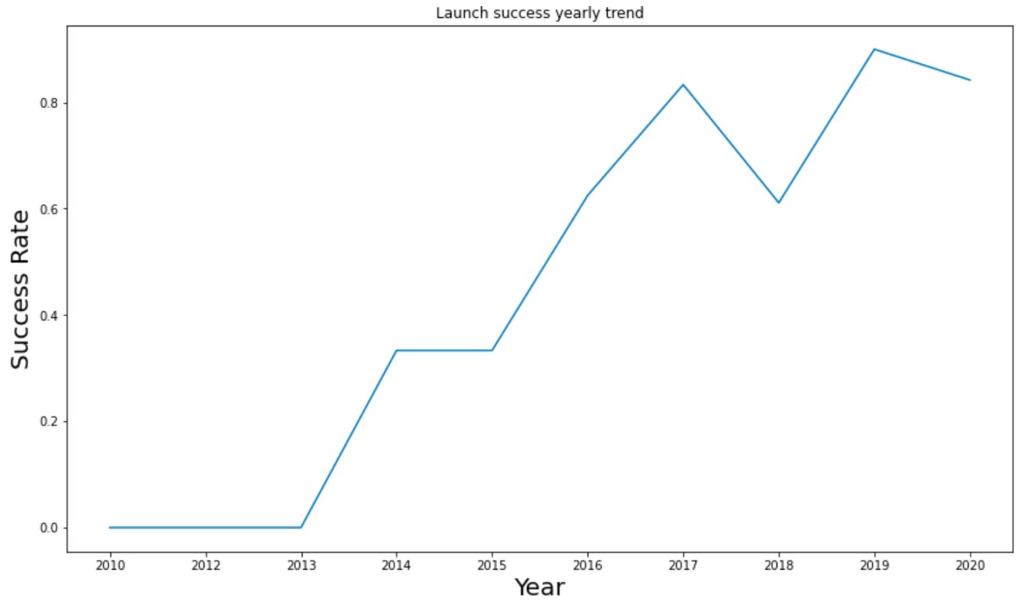
Matplotlib and Seaborn
Launch success yearly trend

Slide 26
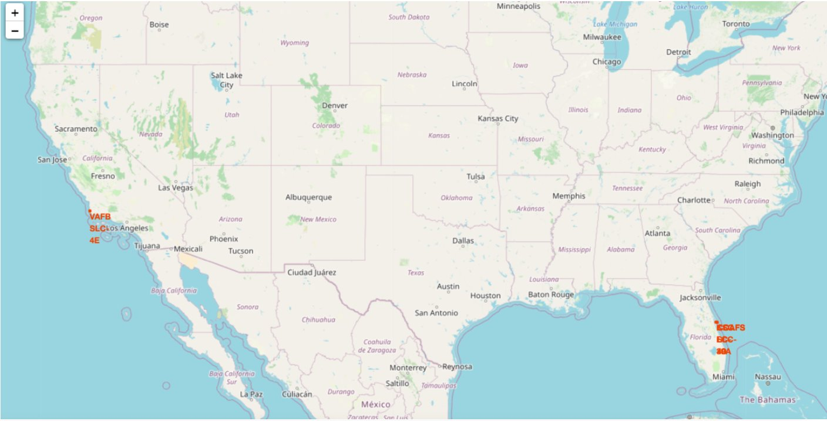
Folium
All launch sites

Slide 27
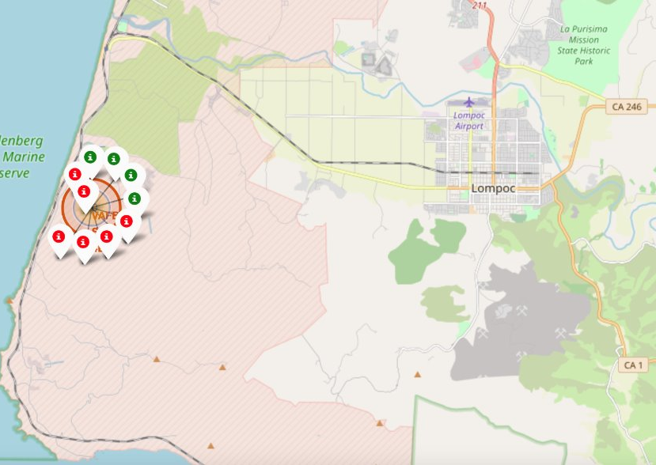
Folium
The succeeded launches and failed launches for each site on map

Slide 28
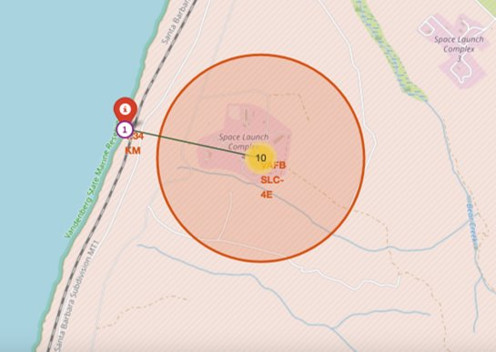
Folium
The distances between a launch site to its proximities such as the nearest city, railway, or highway

Slide 29

Dash
A pie chart when launch site CCAFS LC-40 is chosen

Slide 30
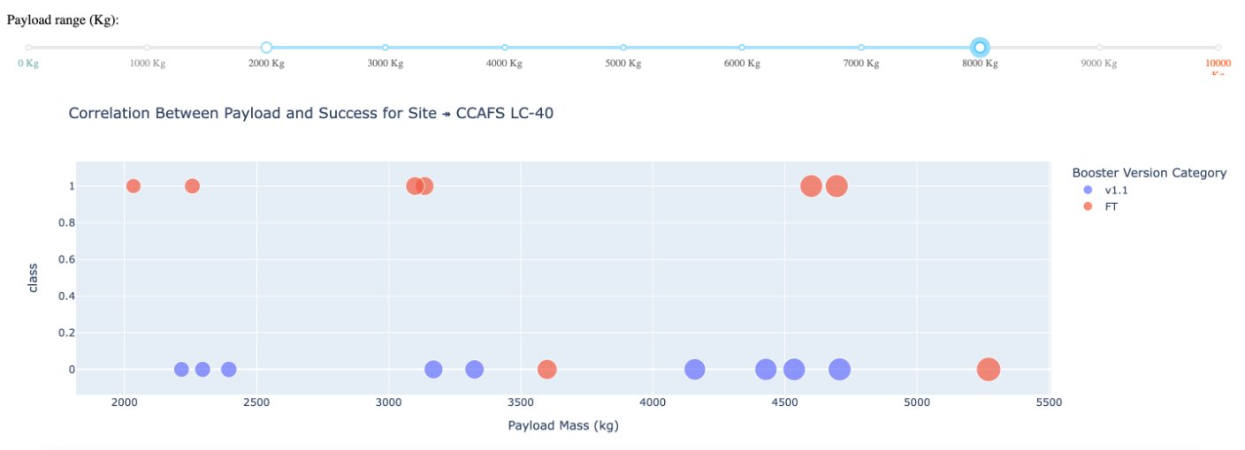
Dash
Scatterplot when the payload mass range is set to be from 2000kg to 8000kg

Slide 31
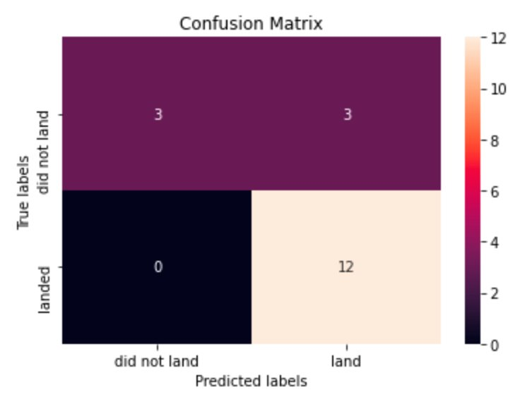
Predictive Analysis (Logistic Regression)
GridSearchCV best score: 0.84643
Accuracy score on test set: 0.834
Confusion matrix:

Slide 32
Predictive Analysis (Support Vector Machine)
GridSearchCV best score: 0.84821
Accuracy score on test set: 0.8334
Confusion matrix:

Slide 33
Predictive Analysis (Decision Tree)
GridSearchCV best score: 0.8893
Accuracy score on test set: 0.8334
Confusion matrix:

Slide 34
Predictive Analysis (K nearest neighbors)
GridSearchCV best score: 0.848214
Accuracy score on test set: 0.8334
Confusion matrix:

Slide 35
Predictive Analysis
Based on the GridSearchCV best scores, the models are ranked in the following order with the first being the best and the last one being the worst:
Decision tree (best score: 0.8893)
K nearest neighbors ( best score: 0.84821)
Support vector machine ( best score: 0.84821)
Logistic regression ( best score: 0.84643)

Slide 36
Conclusion
In this project, we aim to predict whether the Falcon 9 rocket’s first stage will successfully land so we can estimate the launch cost more accurately.
Different launch features—like payload mass and orbit type—can influence whether the mission succeeds or fails.
We use several machine learning algorithms to analyze patterns in past Falcon 9 launches and build models that can predict future outcomes.
Among the four algorithms tested, the decision tree model provided the most accurate predictions.

Slide 37


